Slide 1
Python Crash Course
Marlabs

Slide 2
Table of Content
Python Basics
Python Data Science Related Packages
Other Useful Packages
Assignments

Slide 3
Python Basics
Numbers
Variable Assignment
Strings
Printing
Lists
Dictionaries
Booleans
Tuples
Sets
Comparison Operators
Logic Operations
If, elif, else statetmens
For loops
While loops
Range
List comprehension
Functions
Lambda expression
Map & filter
Methods
Shallow & Deep Copy
File Name
1.Python Basics.ipynb

Slide 4
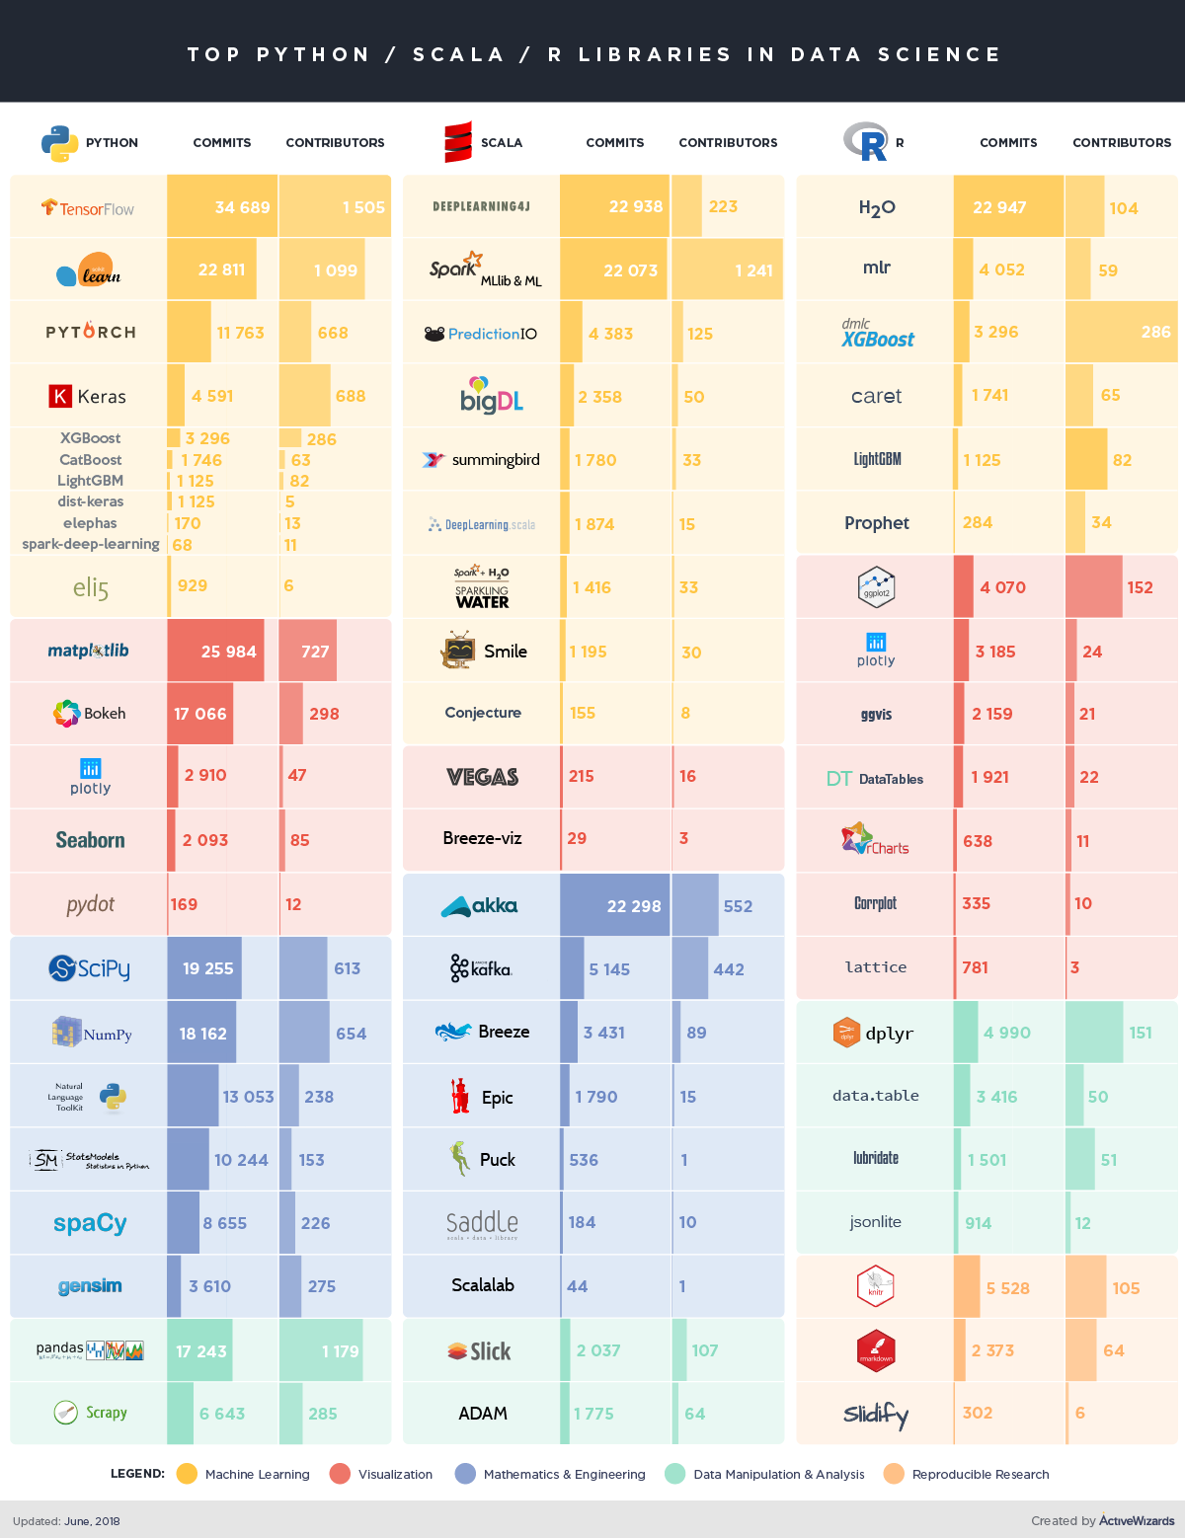
Python Packages
Package Name | What for? | Notebook
Numpy | Mathematics | 2Library_Numpy.ipynb
Pandas | Data Manipulation | 3Library_Pandas.ipynb
datetime | Data Manipulation | 4Library_DateTime.ipynb
Scikit-Learn | Machine Learning | 5Library_Scikit-Learn.ipynb
Matplotlib Seaborn Bokeh Plotly | Visualization | 6Library_matplotlib_seaborn_bokeh_plotly.ipynb

Slide 5
ISO 8601 UTC
0 -> 1 2 –12
%Y%M%DT%H:%M:%S%z
Directive | Meaning | Example
%a | Weekday as locale’s abbreviated name. | Sun, Mon, …, Sat (en_US); So, Mo, …, Sa (de_DE)
%A | Weekday as locale’s full name. | Sunday, Monday, …, Saturday (en_US); Sonntag, Montag, …, Samstag (de_DE)
%w | Weekday as a decimal number, where 0 is Sunday and 6 is Saturday. | 0, 1, …, 6
%d | Day of the month as a zero-padded decimal number. | 01, 02, …, 31
%b | Month as locale’s abbreviated name. | Jan, Feb, …, Dec (en_US); Jan, Feb, …, Dez (de_DE)
%B | Month as locale’s full name. | January, February, …, December (en_US); Januar, Februar, …, Dezember (de_DE)
%m | Month as a zero-padded decimal number. | 01, 02, …, 12
%y | Year without century as a zero-padded decimal number. | 00, 01, …, 99
%Y | Year with century as a decimal number. | 1970, 1988, 2001, 2013
%H | Hour (24-hour clock) as a zero-padded decimal number. | 00, 01, …, 23
%I | Hour (12-hour clock) as a zero-padded decimal number. | 01, 02, …, 12
%p | Locale’s equivalent of either AM or PM. | AM, PM (en_US); am, pm (de_DE)
%M | Minute as a zero-padded decimal number. | 00, 01, …, 59
%S | Second as a zero-padded decimal number. | 00, 01, …, 59
%f | Microsecond as a decimal number, zero-padded on the left. | 000000, 000001, …, 999999
%z | UTC offset in the form +HHMM or -HHMM (empty string if the the object is naive). | (empty), +0000, -0400, +1030
%Z | Time zone name (empty string if the object is naive). | (empty), UTC, EST, CST
%j | Day of the year as a zero-padded decimal number. | 001, 002, …, 366
%U | Week number of the year (Sunday as the first day of the week) as a zero padded decimal number. All days in a new year preceding the first Sunday are considered to be in week 0. | 00, 01, …, 53
%W | Week number of the year (Monday as the first day of the week) as a decimal number. All days in a new year preceding the first Monday are considered to be in week 0. | 00, 01, …, 53
%c | Locale’s appropriate date and time representation. | Tue Aug 16 21:30:00 1988 (en_US); Di 16 Aug 21:30:00 1988 (de_DE)
%x | Locale’s appropriate date representation. | 08/16/88 (None); 08/16/1988 (en_US); 16.08.1988 (de_DE)
%X | Locale’s appropriate time representation. | 21:30:00 (en_US); 21:30:00 (de_DE)
%% | A literal '%' character. | %

Slide 6
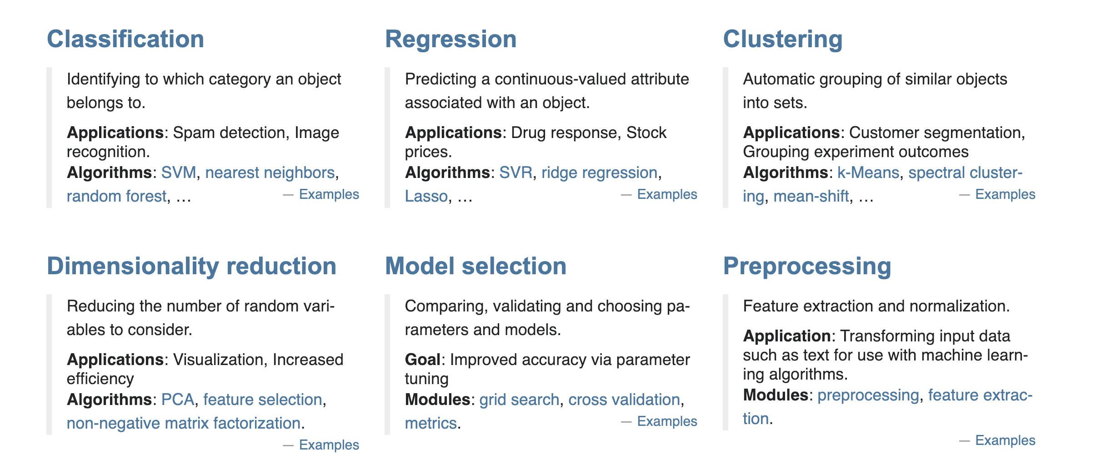
Scikit-Learn

Slide 7
Assignment
Python Assignment 1
Data Wrangling Assignment

